Slide 1
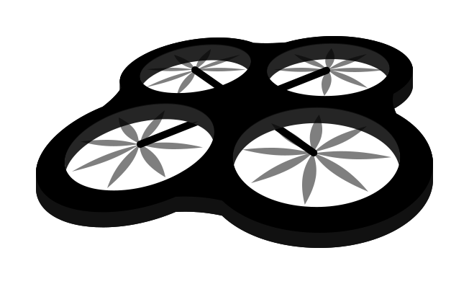


The Drone Delivery Cycle
Drone
Sends Drone with correct taco
Delivers Taco to User
Automated Operator
User
Orders a Taco

Slide 2

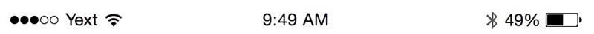
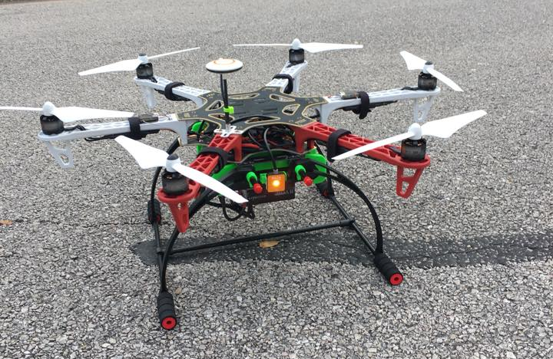

TACO
DRONE
Join TacoDrone the first taco drone delivery service at SXSW…
Terms and Conditions

Slide 3
TACO
DRONE
Terms and Conditions
Supply of Services
Whilst we will use our reasonable endeavours to supply the services, we shall not be responsible for any failure to provide services or any unavailability. We make no warranty against a failure to deliver a taco, a defect or problems which may occur. We will not be responsible for any loss or damage whatsoever caused resulting from a failure to provide you a taco.
Back

Slide 4
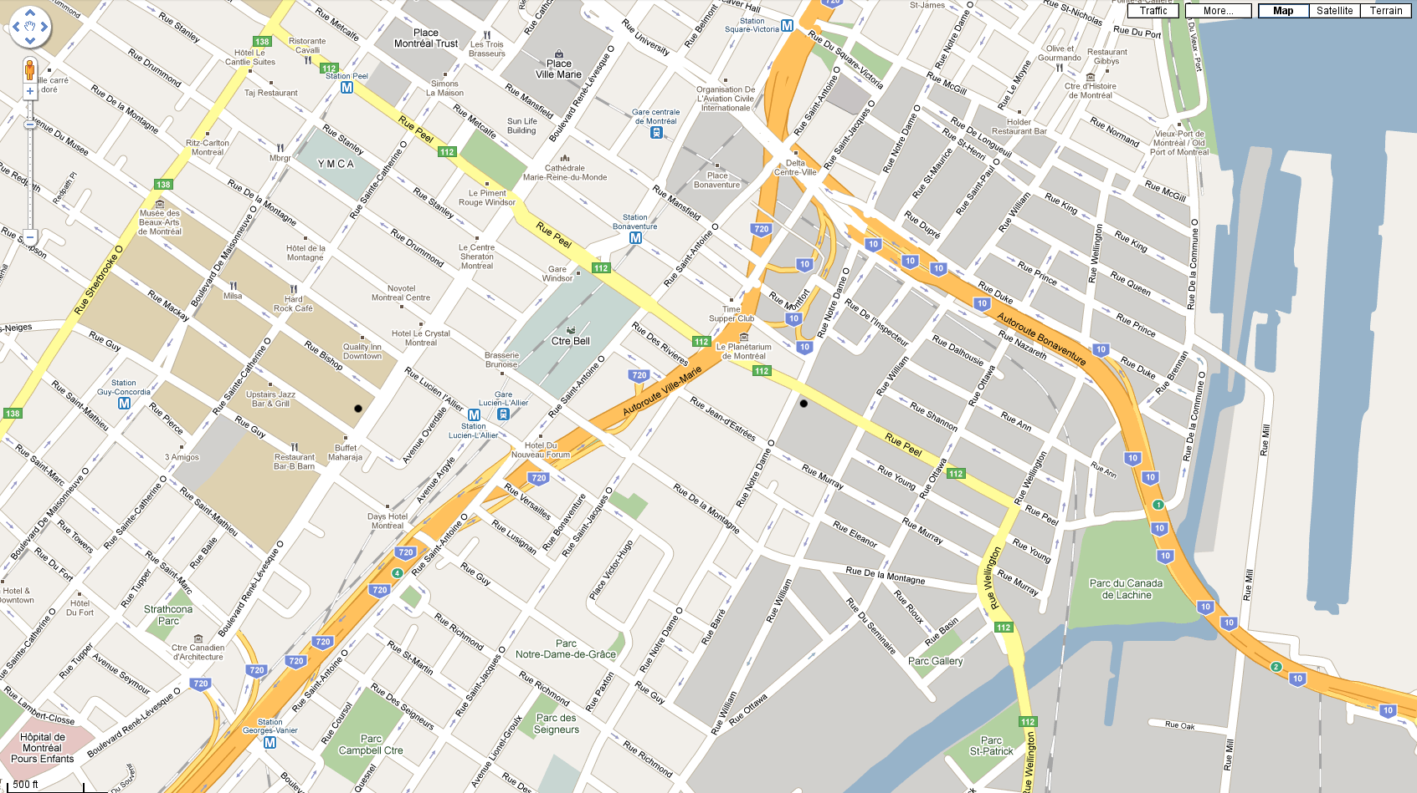

TACO
DRONE
OUT OF RANGE

Slide 5

TACO
DRONE
Type:
ORDER
ETA:
ORDER
5
D
Chicken
mins

Slide 6


TACO
DRONE
Type:
Beef
Chicken
Veggie
CHANGE
CANCEL

Slide 7

TACO
DRONE
4
D
mins

Slide 8
TACO
DRONE
Delivered
Your taco has been delivered.
Close

Slide 9
TACO
DRONE
Thank You
This delivery has been made possible by:
YOUR
COM- -PANY
HERE

